Slide 1


Oracle database
Lecture 50

Slide 2

Today’s Agenda
Collections In PL-SQL
Types Of Collections
Introduction To Associative Array
Using Associative Array
Methods Of Associative Arrays

Slide 3
Collections
A collection is an ordered group of elements having the same data type.
Each element is identified by a unique subscript that represents its position in the collection.
PL/SQL provides three collection types −
Associative array
Nested table
Varray

Slide 4
Associative Array
Associative arrays are sets of key-value pairs, where each key is unique and is used to locate a corresponding value in the array.
These keys can be of type PLS_INTEGER or BINARY_INTEGER or VARCHAR2.
Associative arrays are unbounded form of collection.
This means there is no upper bound on the number of elements that it can hold

Slide 5
Associative Array
Assigning a value using a key for the first time adds that key to the associative array.
Subsequent assignments using the same key will update the same entry.

Slide 6
Declaring An Associative Array
Declaring an associative array is a two-step process.
First, we declare an associative array type.
And then, we declare an associative array variable of that type.

Slide 7
Declaring An Associative Array
Syntax:
TYPE <associative_array_name> IS TABLE OF <datatype>
INDEX BY index_type;
In this syntax:
The associative_array_name is the name of the associative array type.
The datatype is the data type of the elements in the array.
The index_type is the data type of the index used to organize the elements in the array.

Slide 8
Example
TYPE Names IS TABLE OF VARCHAR2(20)
INDEX BY BINARY_INTEGER;
The above statement declares an associative array type called Names , which will hold varchar2 values and their indexes will also be of BINARY_INTEGER type

Slide 9
Declaring An Associative Array Variable
After having the associative array type, we need to declare an associative array variable of that type by using this syntax:
<var_name> <associative_array_name>;
For example, this statement declares an associative array variable called Countries with the type Names:
Countries Names;

Slide 10
Accessing An Associative Array
To access an array element, we use this syntax:
array_name(index)
Note that index can be a number or a character string.
If we give an index which is not present in the array then NO_DATA_FOUND exception will be thrown

Slide 11
Assigning Value To Associative Array
To assign a value to an associative array element, we use the assignment operation (:=):
array_name(index) := value;

Slide 12
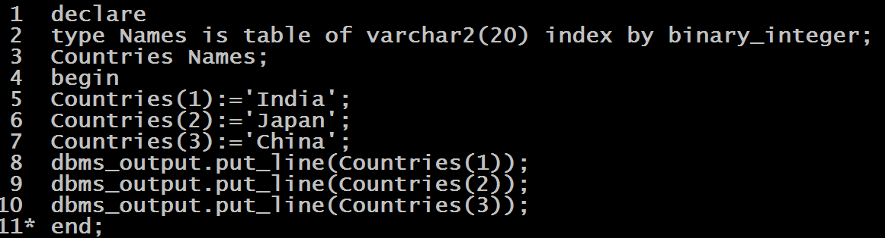
Example

Slide 13
Exercise
WAP to fetch names of all the books from the ALLBOOKS table , store them in an associative array and then print them.

Slide 14
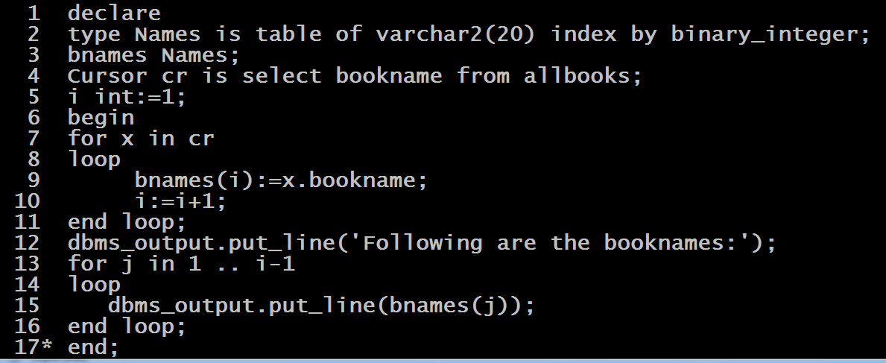
Solution

Slide 15
Using Varchar2 Index
As mentioned before , an associative array can have a varchar2 index also as shown below:
TYPE Names IS TABLE OF VARCHAR2(20)
INDEX BY VARCHAR2(20);
Now each index of this array itself will be a string acting as the key for its value

Slide 16
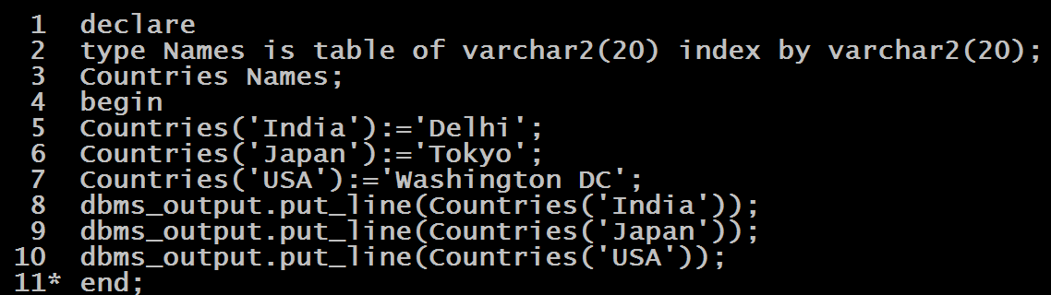
Example

Slide 17
Associative Array Methods
Associative arrays have a number of useful methods for accessing array element index and manipulating elements effectively.
Syntax Of Calling The Methds:
<associative_array_var>.<method_name>(<arguments>);

Slide 18
Associative Array Methods
EXISTS(n) Returns TRUE if the nth element exists in the array
COUNT Returns the number of elements that the array currently contains
FIRST | LAST Returns the first and last (smallest and largest) index number in a PL/SQL table. Returns NULL , if it is empty or no more elements are present

Slide 19
Associative Array Methods
PRIOR (n) Returns the index number that precedes the given index in the array
NEXT (n) Returns the index number that succeeds the given index in the array
DELETE Removes all elements from the array
DELETE (n) Removes n elements from the array
DELETE (m,n) Removes all elements in range from m..n from the array

Slide 20
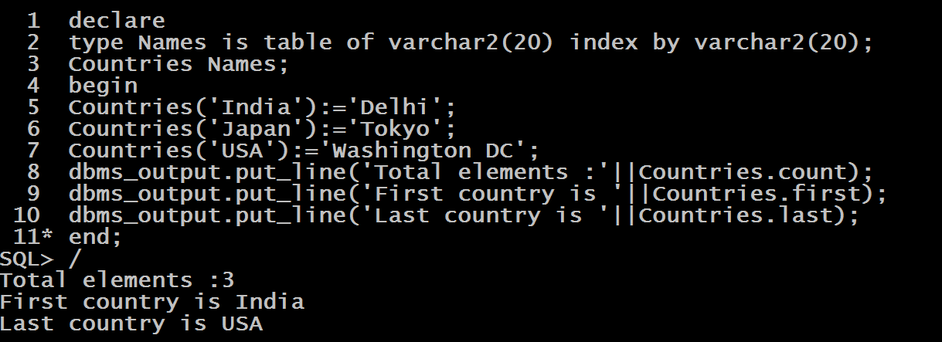
Example

Slide 21
Exercise
WAP to fetch names and prices of all the books from the ALLBOOKS table , store them in an associative array and then print them.

Slide 22
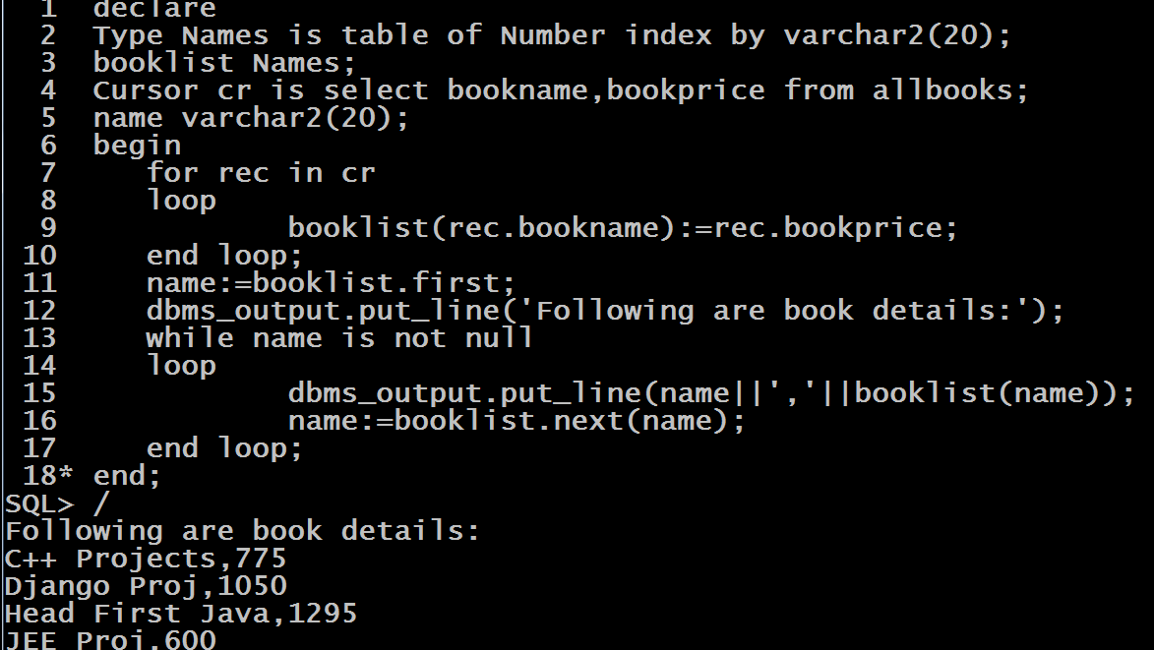
Solution

